Slide 1


IMPLEMENTATION OF CNN FROM SCRATCH FOR HAND GESTURE RECOGNITION
GROUP 3 : PARTHAN OLIKKAL
NISHANJAN RAVIN
AMBROSE TUSCANO

Slide 2
Introduction
Train a model, using the neural network machine learning algorithm, to be capable of recognizing different hand gestures, such as a closed fist, open palm, victory sign and others.
Convolutional neural networks aim to use the spatial locality of images to extract useful features of the image, which then aid in classifying the images more accurately.
Computer will have to "learn" the features of each gesture and classify them correctly.
Implementation of this system from scratch in python, without any external deep learning libraries

Slide 3
Related Work
ImageNet Classification with Deep Convolutional Neural Networks. -Alex Krizhevsky et.al., (2012)
Survey on Gesture Recognition for Hand Image Postures. - Rafiqul Zaman Khan et.al., (2012)
Static Hand Gesture Recognition Based on Convolutional Neural Networks.
- Raimundo F. Pinto Jr. , et. al., (2019)
Color-based object segmentation method using artificial neural network. - Ahmad B.A. Hassanat, et. al., (2016)
Human Hand Gesture Recognition Using a Convolution Neural Network. - Hsien-I Lin et.al., (2014)
Deep Gesture: Static Hand Gesture Recognition Using CNN. -Aparna Mohanty et.al, (2019)
Hand Gesture Recognition Using Neural Networks : - Klimis Symeonidis, (2010)
Recent Advances in Convolutional Neural Networks: - Jiuxiang Gua et.al., (2017)
Hand Gesture Recognition with 3D Convolutional Neural Networks :- Pavlo Molchanov et.al., (2015)
Understanding the difficulty of training deep feedforward neural networks :- Xavier Glorot et.al., (2010)
For information on optimal weight vector initialization
Cyclical Learning Rates for Training Neural Networks :- Leslie N. Smith, (2015)
For information on optimal learning rates

Slide 4
Methodology
Manually create a dataset of gestures for training
Achieve proper preprocessing and normalization of this dataset
Create a simple neural network (fully connected single-layer) in Python
Note down its performance metrics on the dataset
Add an additional hidden layer to the NN, and note down the improvement in its performance metrics
Repeat step 5 by adding different types of hidden layers to the NN, such as convolutional layers and max-pool layers, to make a CNN → Currently at this step
Experiment with different hyperparameter settings (activation functions, number of hidden nodes per layer, weight vector initialization, learning rates, etc.) to achieve optimal performance of the CNN
Parthan → Pre-processing & experimentation on dataset Nishanjan & Ambrose → Improvements to the Convolutional Neural Network

Slide 5



Results - Preprocessing
Automated image capturing
Initially images were converted into grayscale to be fed into the neural network
Scaled down the images to a lower resolution
Changed strategy to use Otsu’s thresholding to convert to binary scale
Classifies pixels to black or white depending on threshold value
Speed - Uses bi model histogram
Uniform Illumination
OK
Palm
Victory

Slide 6
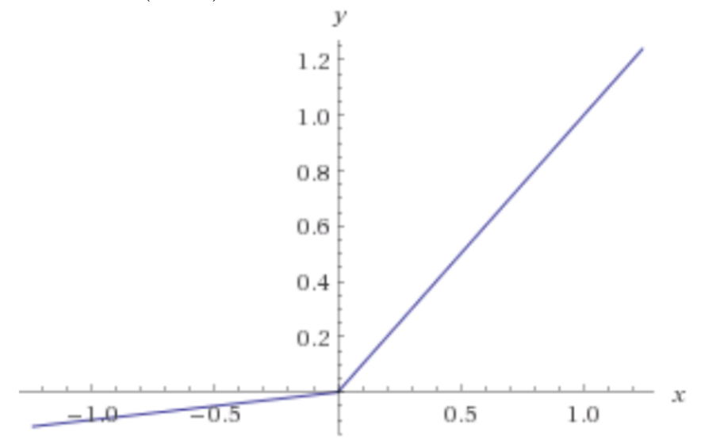
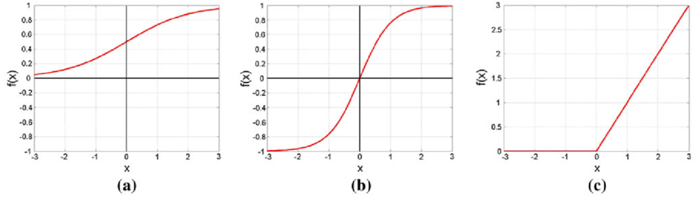
Results - CNN Experimentation
Activation Functions tested:
Sigmoid activation
Tanh activation
ReLU activation
Leaky ReLU activation → most effective
Sigmoid and Tanh activations has a higher probability of experiencing vanishing/exploding gradients problem
ReLU activation risks the possibility of killing neurons forever → large part of CNN may become dead
Leaky ReLU offers a good compromise
Leaky ReLU
Sigmoid
Tanh
ReLU

Slide 7
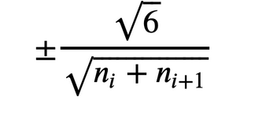
Results - CNN Experimentation
Weight vectors initialisation
Random initialization of values between -1 and 1
Concept → maintaining the standard deviation of layers’ activations around 1 will allow us to stack several more layers in a deep neural network without gradients exploding or vanishing
Xavier initialization → more suitable for sigmoid and tanh activations
Layer’s weight values are chosen from a random uniform distribution that’s bounded between a calculated range
Kaiming initialization → more suitable for ReLU activations
The weight vector values are sampled from a normal distribution, and then multiplied by √(2/n_{i})
Bias values are initialized to 0
n_{i} is the number of incoming connections from the previous layer, aka “fan-in”, and n_{i+1} is the number of outgoing connections from the layer, aka “fan-out”
Xavier initialization

Slide 8
Results - CNN Evaluation
Structure of CNN implemented so far:
1 Convolutional Layer + Maxpool Layer with Leaky ReLU activation
50 Filters, each of size 20 × 20
Maxpool of size 2
1 Hidden Layer with Leaky ReLU activation
10 Nodes
1 Output Layer with Softmax activation
Cross-entropy Loss function
Configurations of CNN:
Train to Test Ratio = 80:20
Learning rate = 0.005
Evaluation
Achieved Test Accuracy = 67.5%
Achieved Train Accuracy = 98%
Training Time (CPU) = 7.13 Hours (50 Epochs)

Slide 9
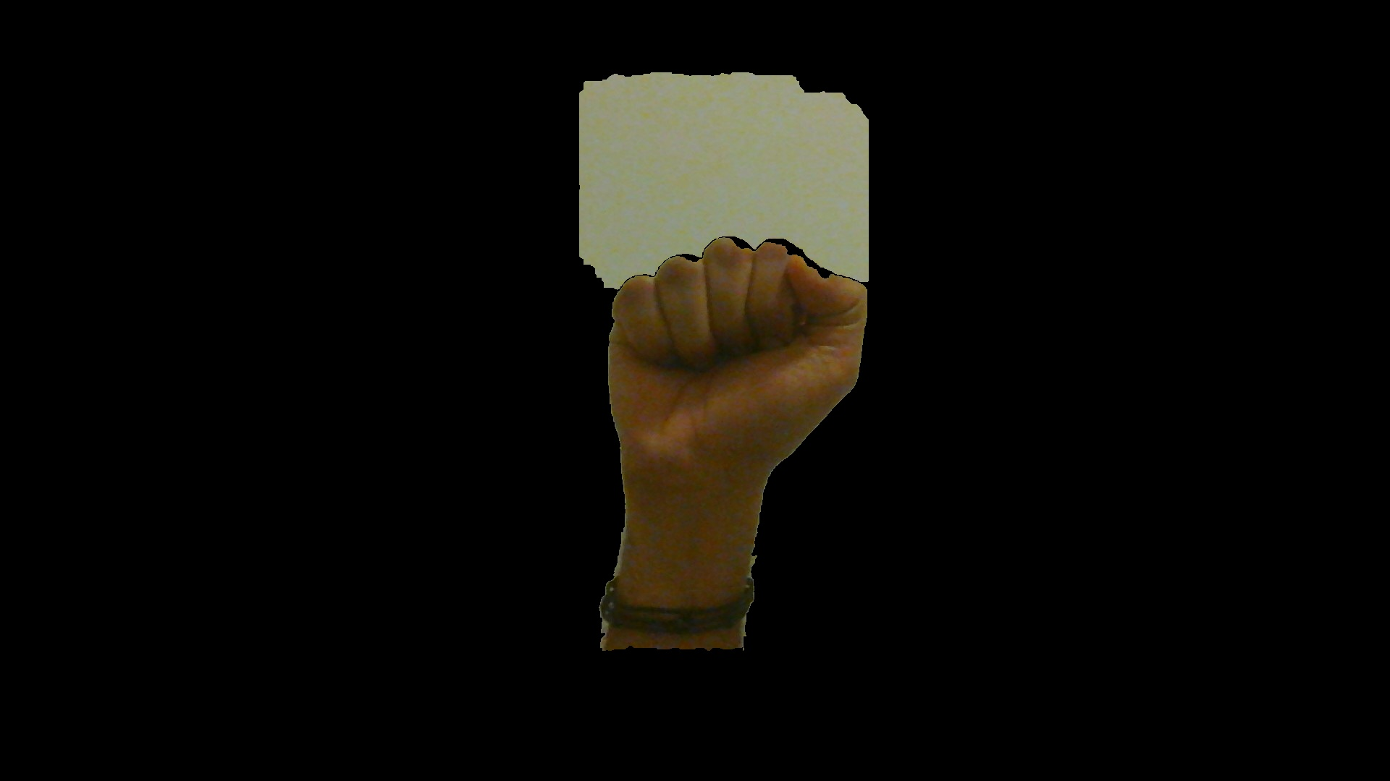
Plan for Completion - Preprocessing
Strategies under consideration
Background Subtraction
Usually used to track dynamically moving objects in a static camera
Grab Cut
Makes use of the bounding box rectangle specified by the user and checks for a color distribution of the target image and background
Helps in preserving the edges of the image
Need to automate the user specified rectangle
Region Based Segmentation
Pixel aggregation

Slide 10
Plan for Completion - CNN
Add more convolution, maxpool, and fully connected hidden layers
Implement adaptive learning rates for faster convergence to optimal performance
E.g. Cyclic learning rates, Exponential decay learning rate, etc.
Experiment with different hyperparameter settings to maximize performance on test-set
Look at CUDA implementation for training the CNN on GPUs to reduce training times
Currently considering a possible implementation using the “numba” library in python

Slide 11
Questions?

